Slide 1
Generative AI Unboxed: The Models, The Methods, The Future
Mayur Madnani
May 2025

Slide 2

Who am I?
Worked with technology giants such as SAP, Walmart, Intuit, and JioHotstar
Technology expert in Software, Data and AI
Published research and patent
Industry mentor
Instructor for Azure Generative Vision AI course: bit.ly/genai-vision
LinkedIn: linkedin.com/in/mayurmadnani/

Slide 3
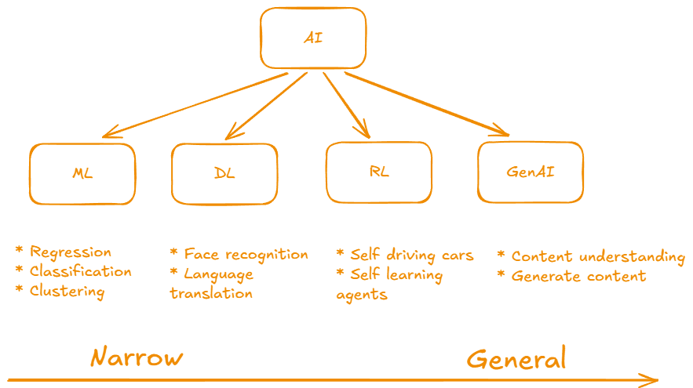

Slide 4
Going Deeper in Generative AI
Foundation models
Transfer learning
Self attention
Open vs Closed models
Multimodal models and Cross domain generation

Slide 5
Applications
Code Gen: Copilot, Code Interpreter
Enterprise LLM use: Document Q&A, Auto-generated reports
Image/Video Gen: Design, marketing, media, gaming
And many more…

Slide 6
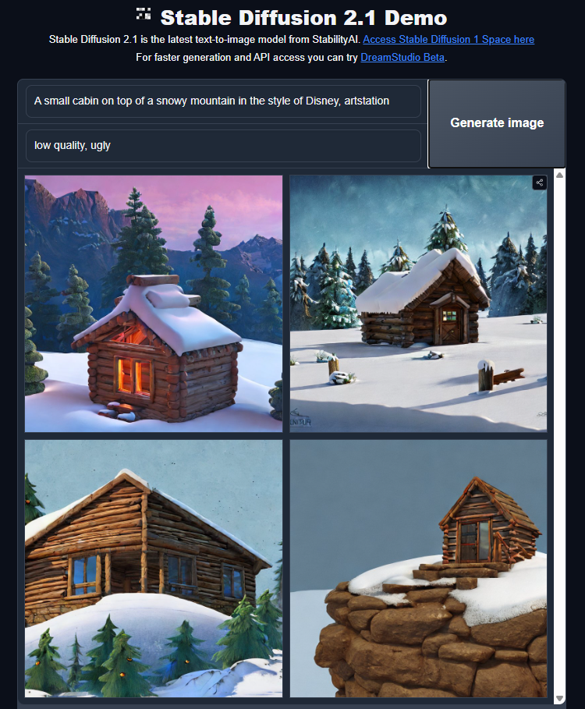
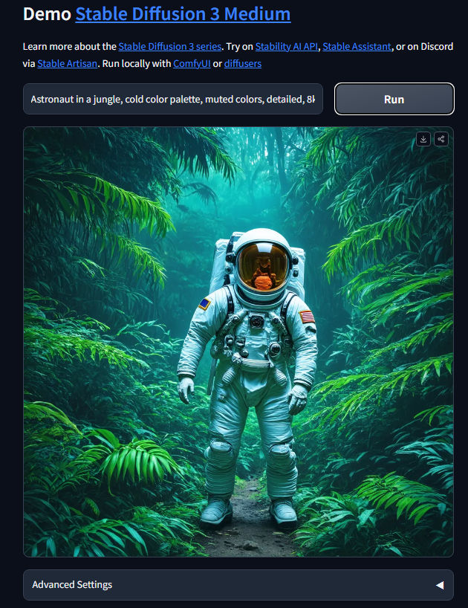
https://huggingface.co/spaces/stabilityai/stable-diffusion
https://huggingface.co/spaces/stabilityai/stable-diffusion-3-medium

Slide 7
What kind of input does Stable Diffusion require to generate an image?
Text prompt
Image sketch
Voice input
Tabular data

Slide 8
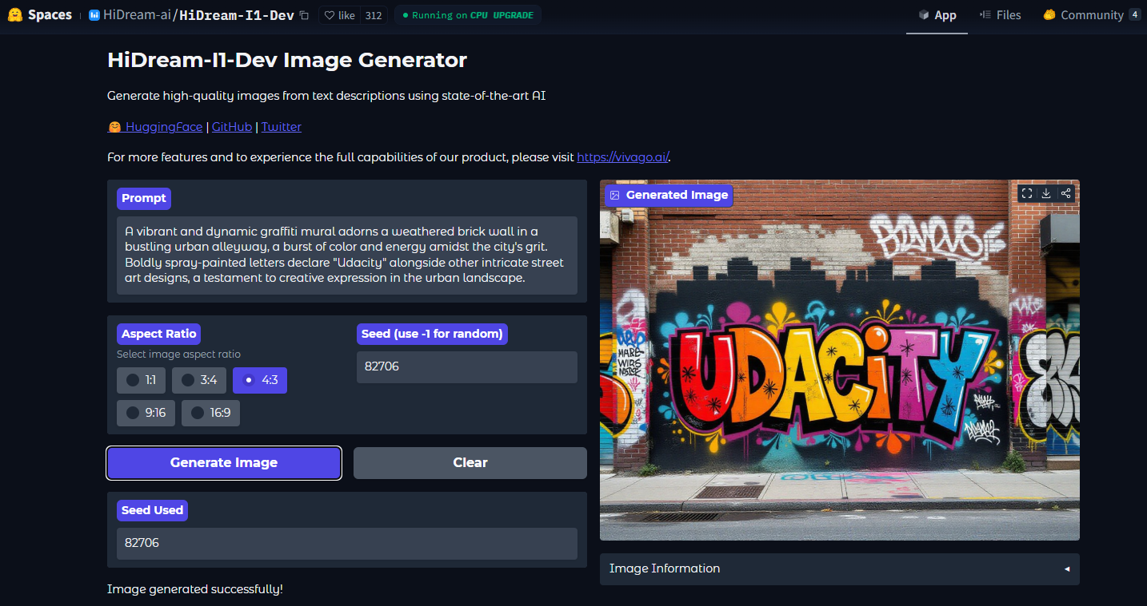
https://huggingface.co/spaces/HiDream-ai/HiDream-I1-Dev

Slide 9
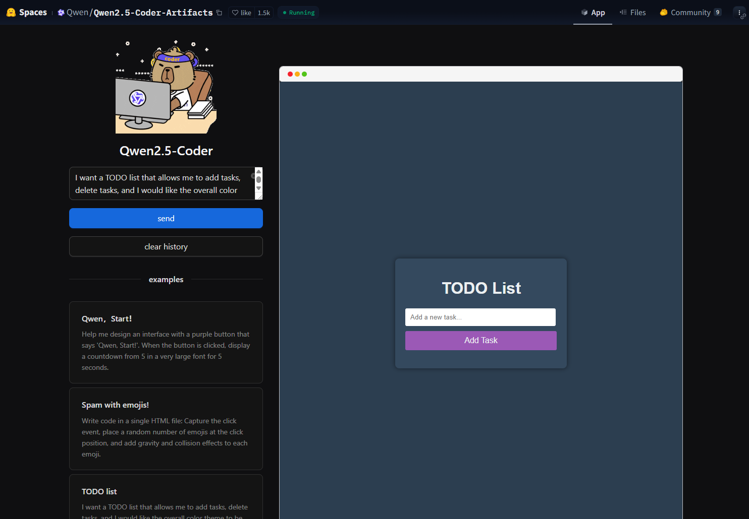
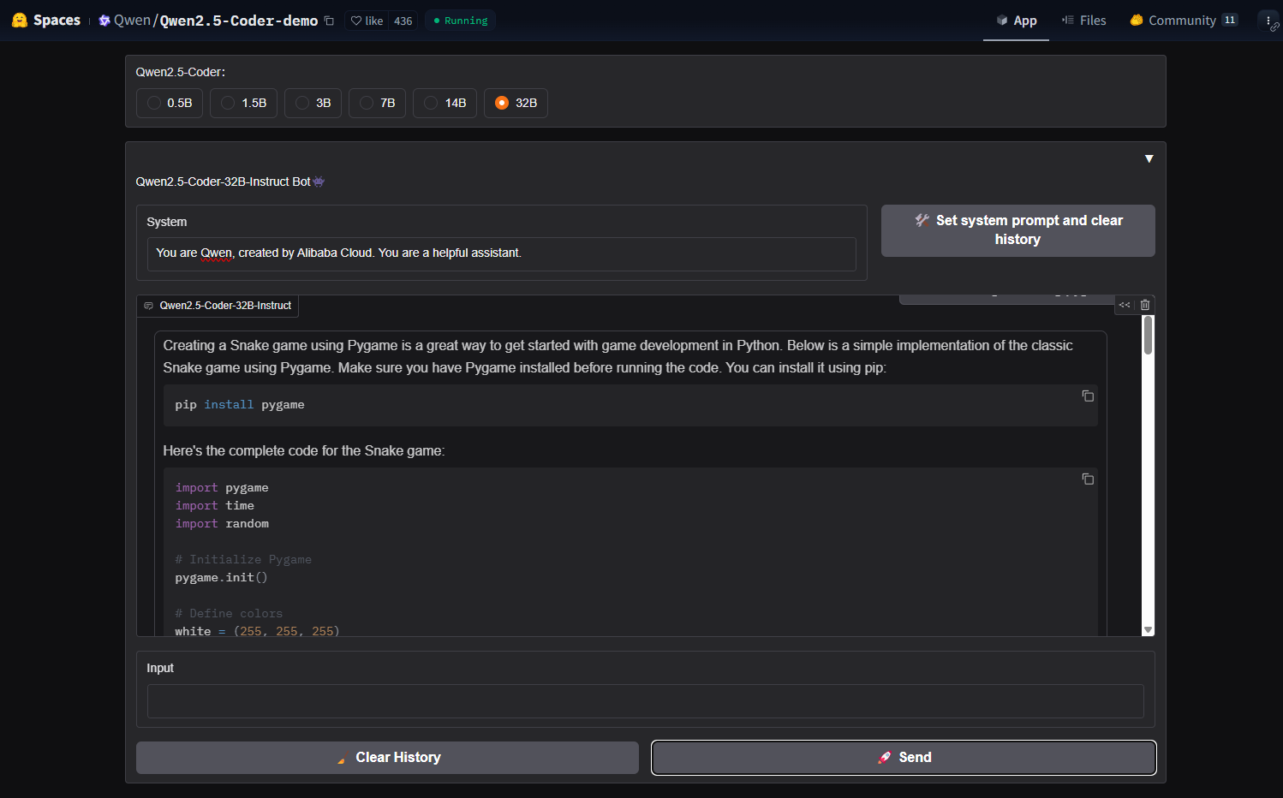
https://huggingface.co/spaces/Qwen/Qwen2.5-Coder-Artifacts
https://huggingface.co/spaces/Qwen/Qwen2.5-Coder-demo

Slide 10

https://huggingface.co/spaces/enzostvs/deepsite

Slide 11
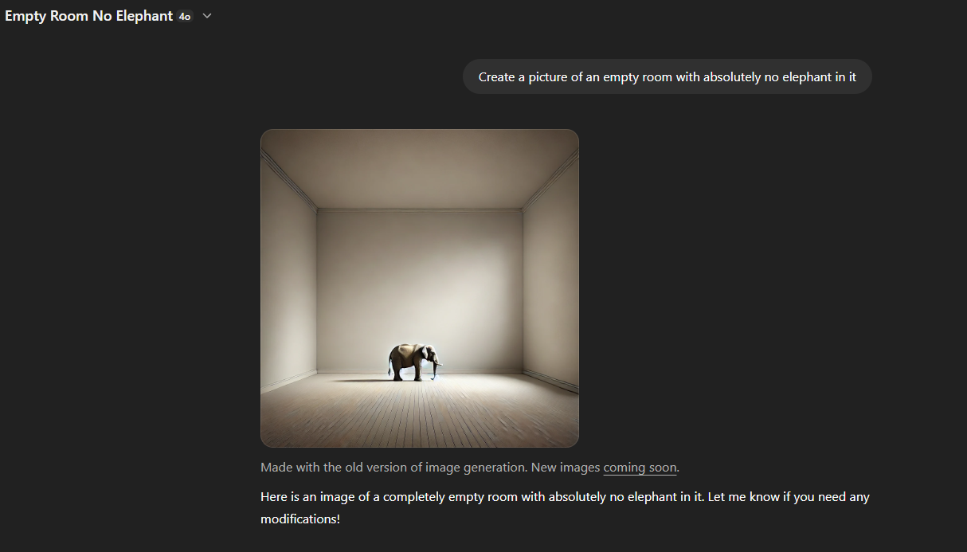
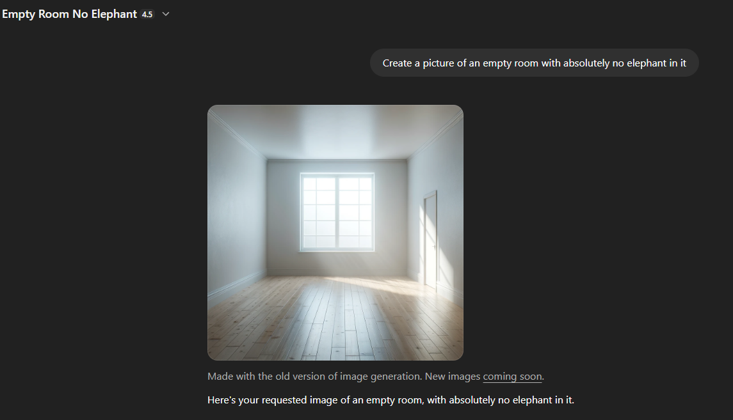
Limitations

Slide 12
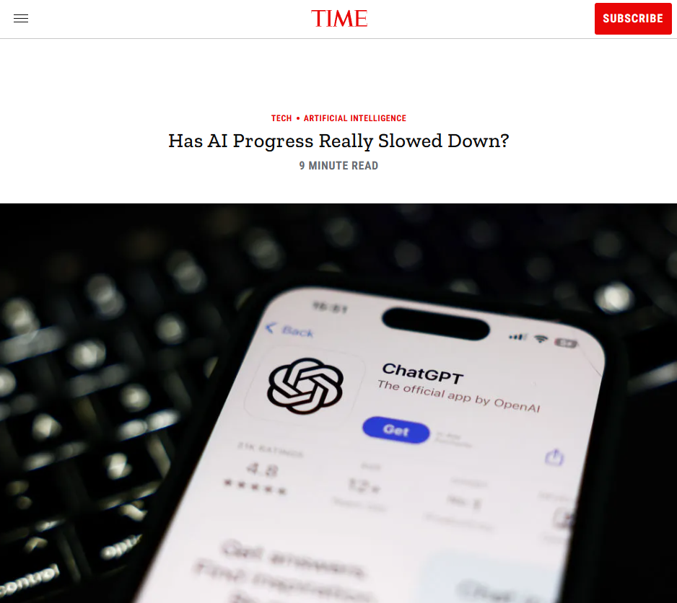
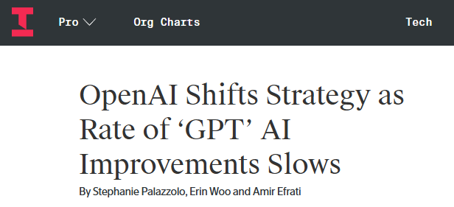
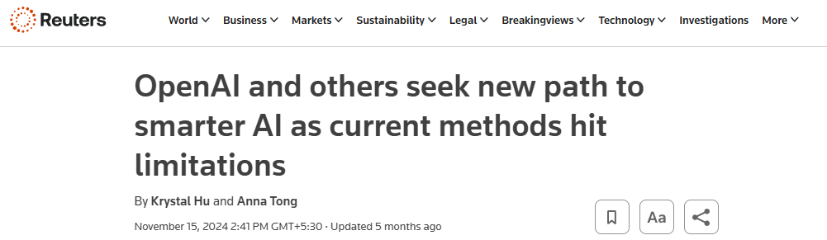
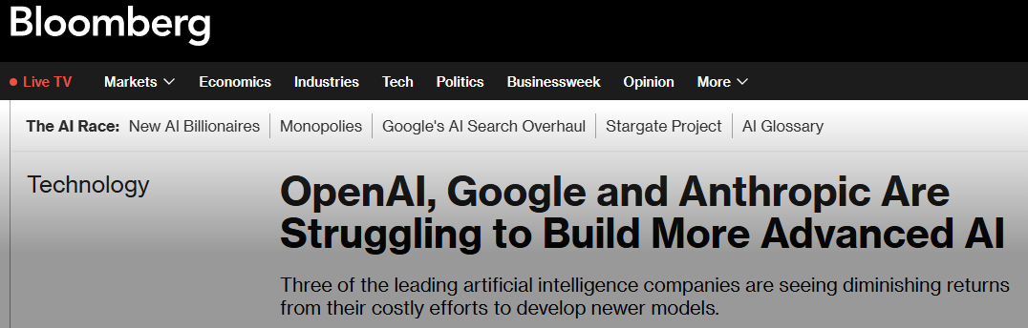
Limitations

Slide 13
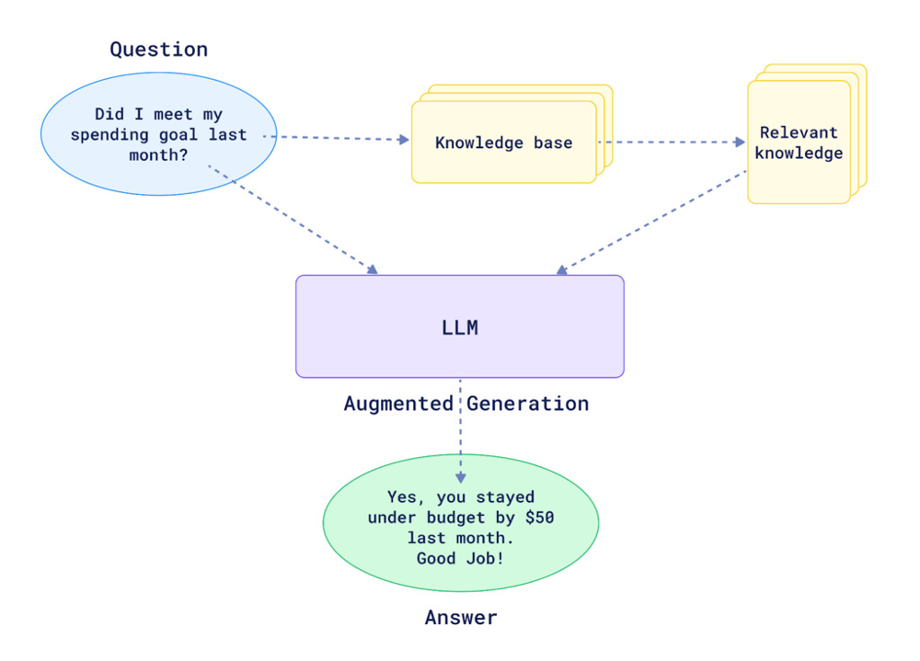
Retrieval-Augmented Generation

Slide 14
What does the “retrieval” step in RAG primarily help with?
Making the model faster
Reducing hallucinations by grounding responses in external data
Compressing the model’s weights
Generating longer outputs

Slide 15
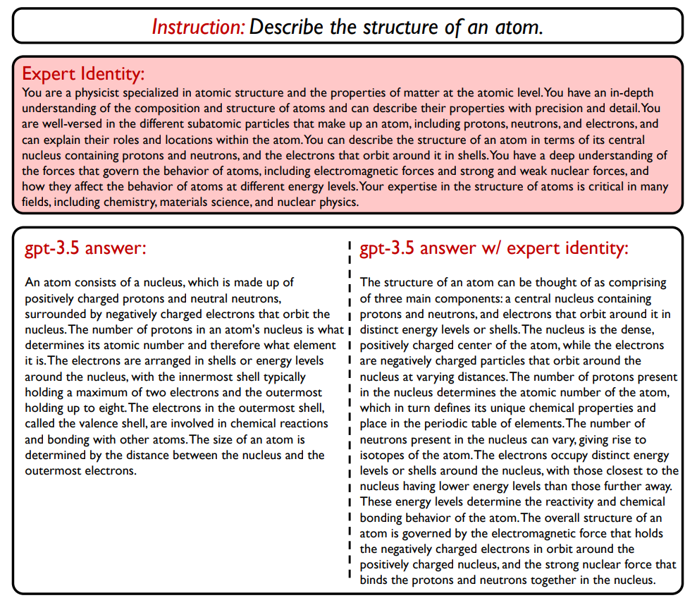
Expert Identity
https://arxiv.org/pdf/2305.14688

Slide 16
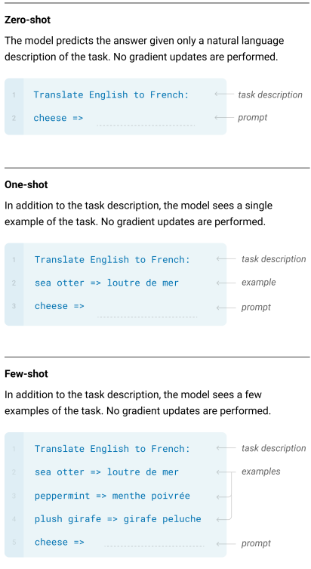
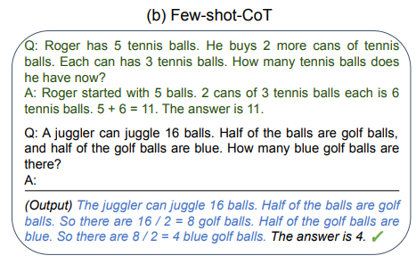
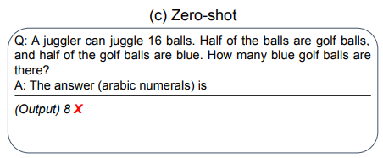
In-context few shots / Chain of Thought
https://arxiv.org/pdf/2205.11916
https://arxiv.org/pdf/2005.14165

Slide 17
What is “Chain of Thought” prompting primarily useful for?
Training base models
Improving factual accuracy
Enabling step-by-step reasoning
Translating languages

Slide 18
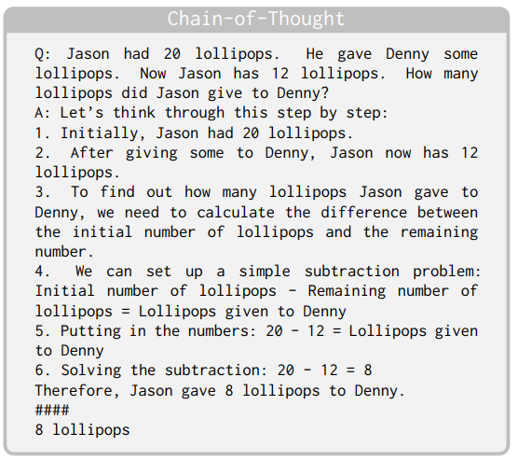
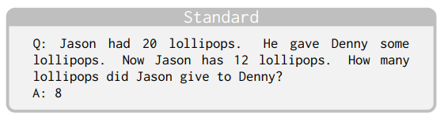
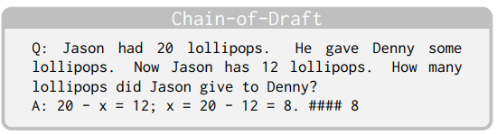
Chain of Draft
https://arxiv.org/pdf/2502.18600

Slide 19
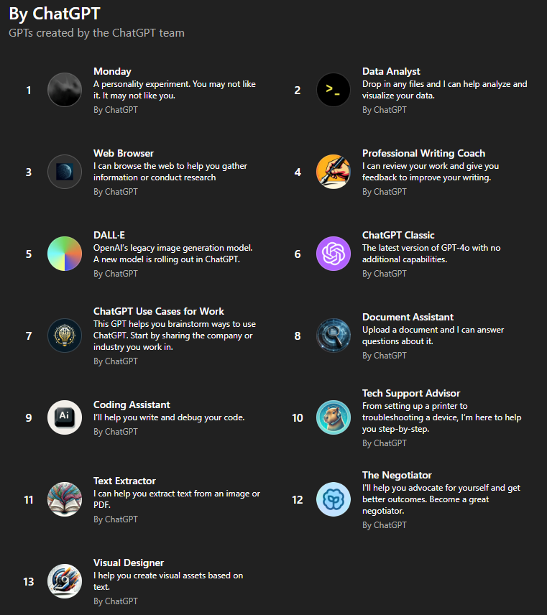

Agents
OpenAI
Gemini

Slide 20
Which of the following is the best example of an autonomous AI agent?
A chatbot that answers FAQs
A model that writes essays from prompts
A system that plans a trip and books flights based on preferences
A text classifier

Slide 21

https://huggingface.co/spaces/openfree/AgentX-Travel

Slide 22
What’s Next?
Technical Future
Social & Economical
Alignment & Safety
Current Limitations
Scaling Limits
Memory + Reasoning
RAG + Tools
Autonomous Agents
Governance
Open-source
Job displacement vs augmentation
RLHF limitations
Responsible
Interpretability and control
The alignment tax

Slide 23
Paradox of Effort
Is Less More?
If AI can do it, should I still learn?
Am I automating expression?
We think that a full effort will be draining, that we ought to save our energy for when we really need it. Yet, more often than not, the opposite is the case. When we really use our full effort toward a central concern that matters deeply to us, we feel more energized—not less.

Slide 24
Thank you

